Slide 1
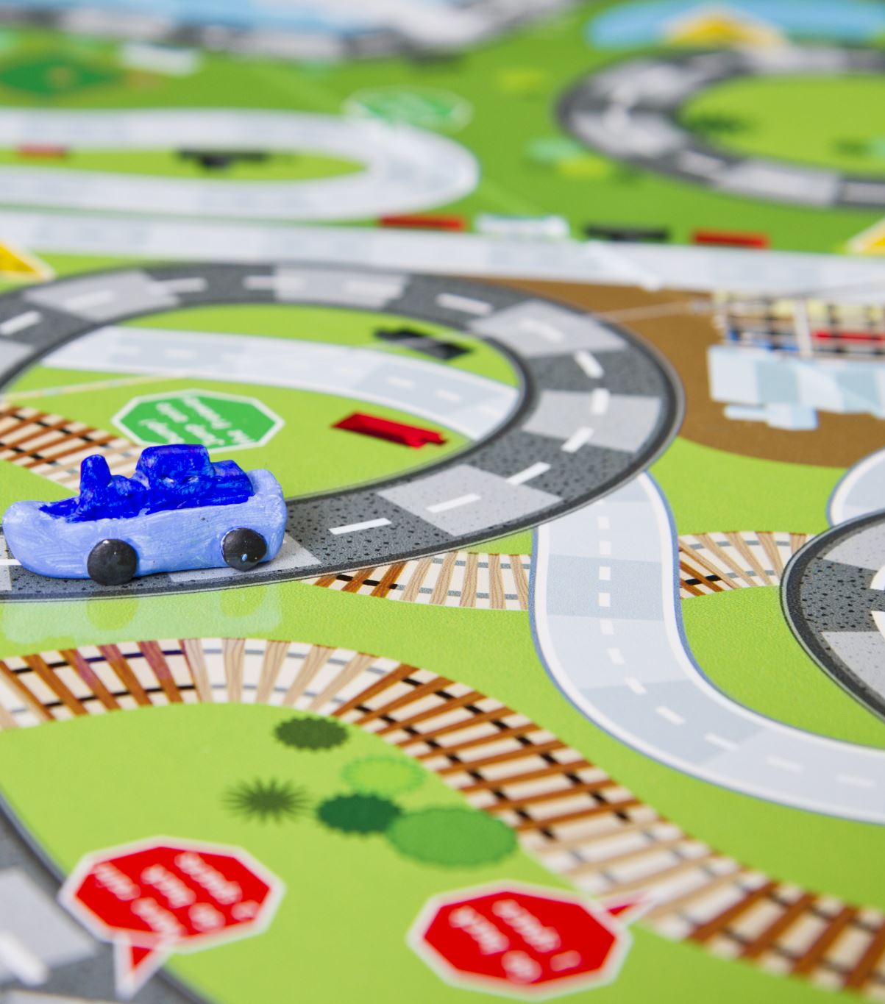
Transport for London API
Mini-Project 1
Jessica Moloney

Slide 2

Air Quality Predictions
Low air pollution forecast valid from Friday 23 September to end of Saturday 24 September GMT

Slide 3

Transport Modes
18 different options:
'bus', 'cable-car', 'coach', 'cycle', 'cycle-hire', 'dlr', 'elizabeth-line', 'interchange-keep-sitting', 'interchange-secure', 'national-rail', 'overground', 'replacement-bus', 'river-bus', 'river-tour', 'taxi', 'tram', 'tube', 'walking'

Slide 4

BikePoints
779 bike points with 20,653 docks

Slide 5

Tube and Bus Lines
678 bus lines
11 tube lines:
'Bakerloo', 'Central', 'Circle', 'District', 'Hammersmith & City', 'Jubilee', 'Metropolitan', 'Northern', 'Piccadilly', 'Victoria', 'Waterloo & City'

Slide 6

Victoria Line
16 stations

Slide 7
Heathrow Airport to Tower Bridge
By Bus: 101 minutes
By Tube: 83 minutes

Slide 8
Most Dangerous Intersections

Slide 9
People Injured at Clapham/Lingham were travelling by:

Slide 10
With More Time
Lines with most service disruptions?
Most crowded bus or tube lines?

Slide 11
Biggest Challenges
Finding correct parameters
01
Saving the API response to a file
02
Navigating nested lists / dictionaries
03

Slide 12

Thank You!

Slide 13
Tools
Started out in Jupyter Lab
Moved to VSCode
Imported Python Packages:
requests
os
json
Can view terminal,
Split screen with txt files,
Predictive text

